Slide 1



CribMaster Smart Evaluator of MRO Supplies
APRIL 10TH 2024
KSU SPRING 2024 CAPSTONE

Slide 2

Background
CribMaster sale representatives and personnel spend many man-hours gathering and analyzing item data based on a client’s inventory in order to provide them with appropriate hardware solutions. In order to increase both the speed and efficiency of this situation, CribMaster is requesting a web-scraping and or artificial intelligence solution that automates this process.

Slide 3
Project Description
A full stack web-solution that utilizes web-scraping and natural language processing to collect data for any industrial tool, analyze its characteristics, and calculate proper placement within CribMaster series of tool storage solutions.

Slide 4
Product Features
User-Friendly, Web-Based Interface
Automated Data Collection and Enrichment
Vendibility
Analysis
Users may upload a list of items and their verbal descriptions via excel spreadsheet.
Once data collection and analysis is completed, the users may export the results to a excel spreadsheet.
The system extracts information about each item and gathers additional information using web scraping and large language models.
The system then uses the data collected to calculate the best vending method.
Item information is stored in the CribMaster item "catalogue" for later use.

Slide 5





Team Members
Matthew Periut
Team Lead
Backend Developer
Cohen Miller
Data Developer
Carter Ray
Frontend Developer
Dawniqueca Steele
UI Designer
Justin Hughes
Automation

Slide 6





Tools & Resources

Slide 7



Milestone Schedule
MILESTONE 1:
FEBRUARY 14TH 2024
MILESTONE 2:
MARCH 20TH 2024
MILESTONE 3:
APRIL 10TH 2024
1) Develop Problem Statement
2) Mock-Ups for end-to-end process
3) Design of back-end Architecture
1) Develop Web-Scraping Pipeline
2) Build Database
3) Develop model utilizing LLM to address the data relating to vendibility.
Application that offers data collection and vendibility solutions based on list of material and sites.

Slide 8
Data Generation

Slide 9

Data Generation Algorithm
5x
Web Scrape Queries
GPT-4-turbo

Slide 10
Previous Chat GPT Prompt
"Item Description:" + item.item_description + "\n" + bingSearch + "\n\nBased on the text above answer the questions. Follow the format provided strictly. If you cannot complete the task respond with\ "impossible" otherwise only provide the data. Prioritize higher precision answers in the text, ensure it is dimensions not $\n\ Q: Provide the item's dimensions in the specified format\n";

Slide 11
Current Chat GPT Prompt
You will be asked for a variable and given a description of the item. You can only reply with two things the first is google("question", "keywords"). If you respond this way, my function will search the internet using the question that you provide, evaluate the first 10 webpages, and return any text within 100 characters of the keywords. Use | to separate keywords. Example usage: google("how tall is mt everest?", "height|feet") If the results is [] it is likely that the keywords did not work. Please include item description in the question variable. If you aren't confident in the data, adjust the keywords and try again. When you have found the answer, you may use the second response: (variable as given): (answer, e.g. "true", "false", "number") However, try not to answer what the variable is until you find it. If you can't find enough data, search again. Follow these guidelines strictly. On the final try you will be informed that you can no longer google search and must reply.

Slide 12
Data Generation Results
How it works
Giving a LLM the ability to search the web via a function named google for simplicity, but is using Scraping Bee.
Data Completion
LLM compares the input data from its requested google searches

Slide 13
Vendibility Analysis

Slide 14
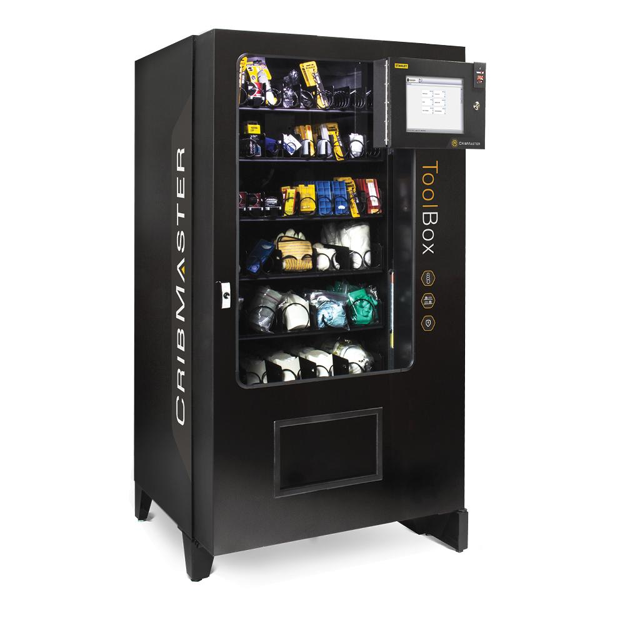
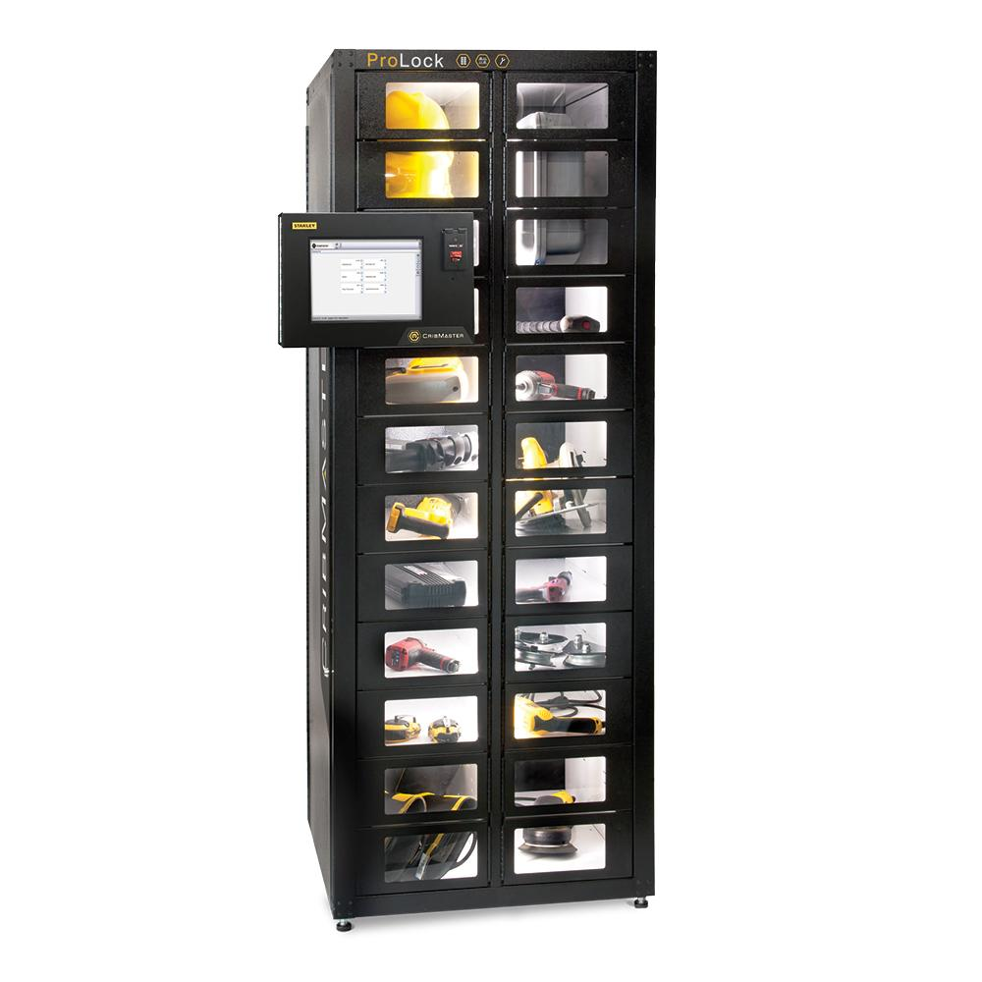
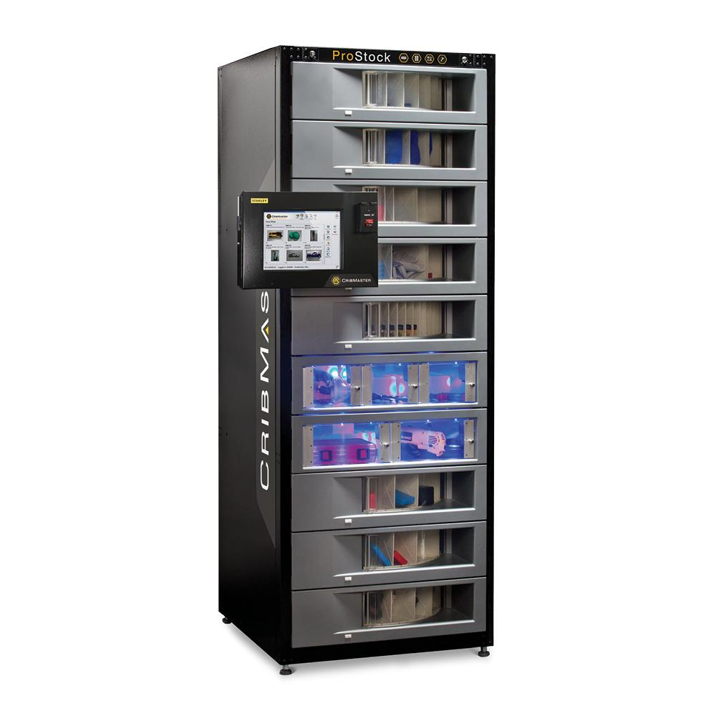
CribMaster Hardware Solutions

Slide 15
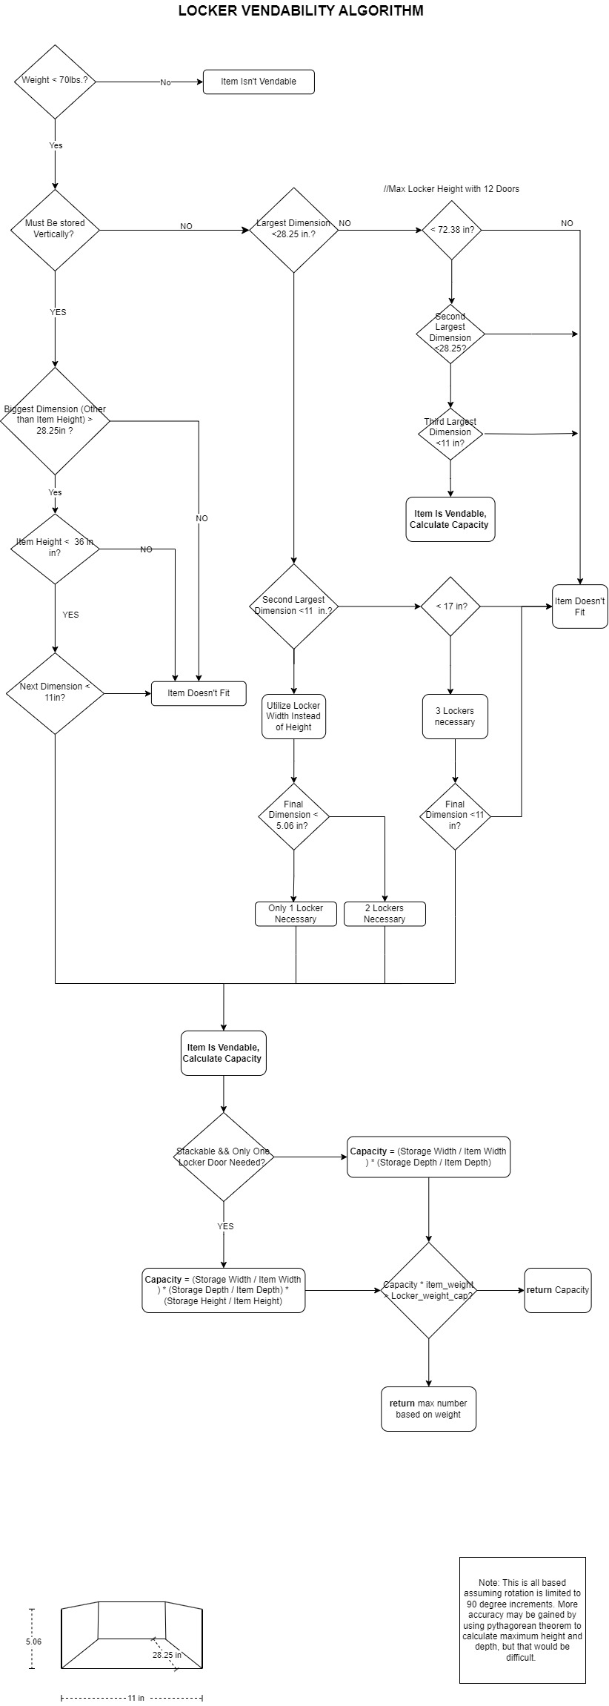
Locker Vendibility
Determines Vendibility by using item’s dimensions and comparing them to the locker’s width/length/height.
It determines the orientation of the item placement and whether it can fit in that particular locker size.
It also determines how many lockers are necessary for the item (ProLock).
Capacity is calculated by dividing the selected length/width/height by its respective dimensions in the locker and rounding down in the case of decimals.

Slide 16
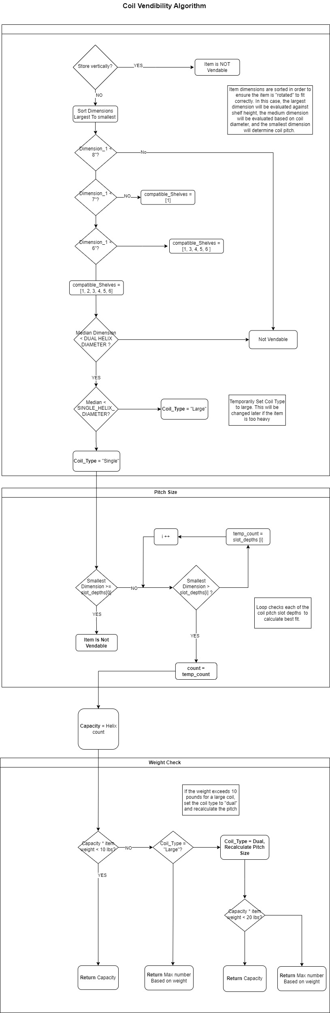
Coil Vendibility
Determines Vendibility based on the item's dimensions, the code identifies the most appropriate coil type (single, large, or dual)
Calculates Capacity by determining number of items that can fit within a single coil of the chosen type. This is done by dividing the usable length of the coil (depending on the chosen coil type) by the item's length and rounding down any decimals.

Slide 17
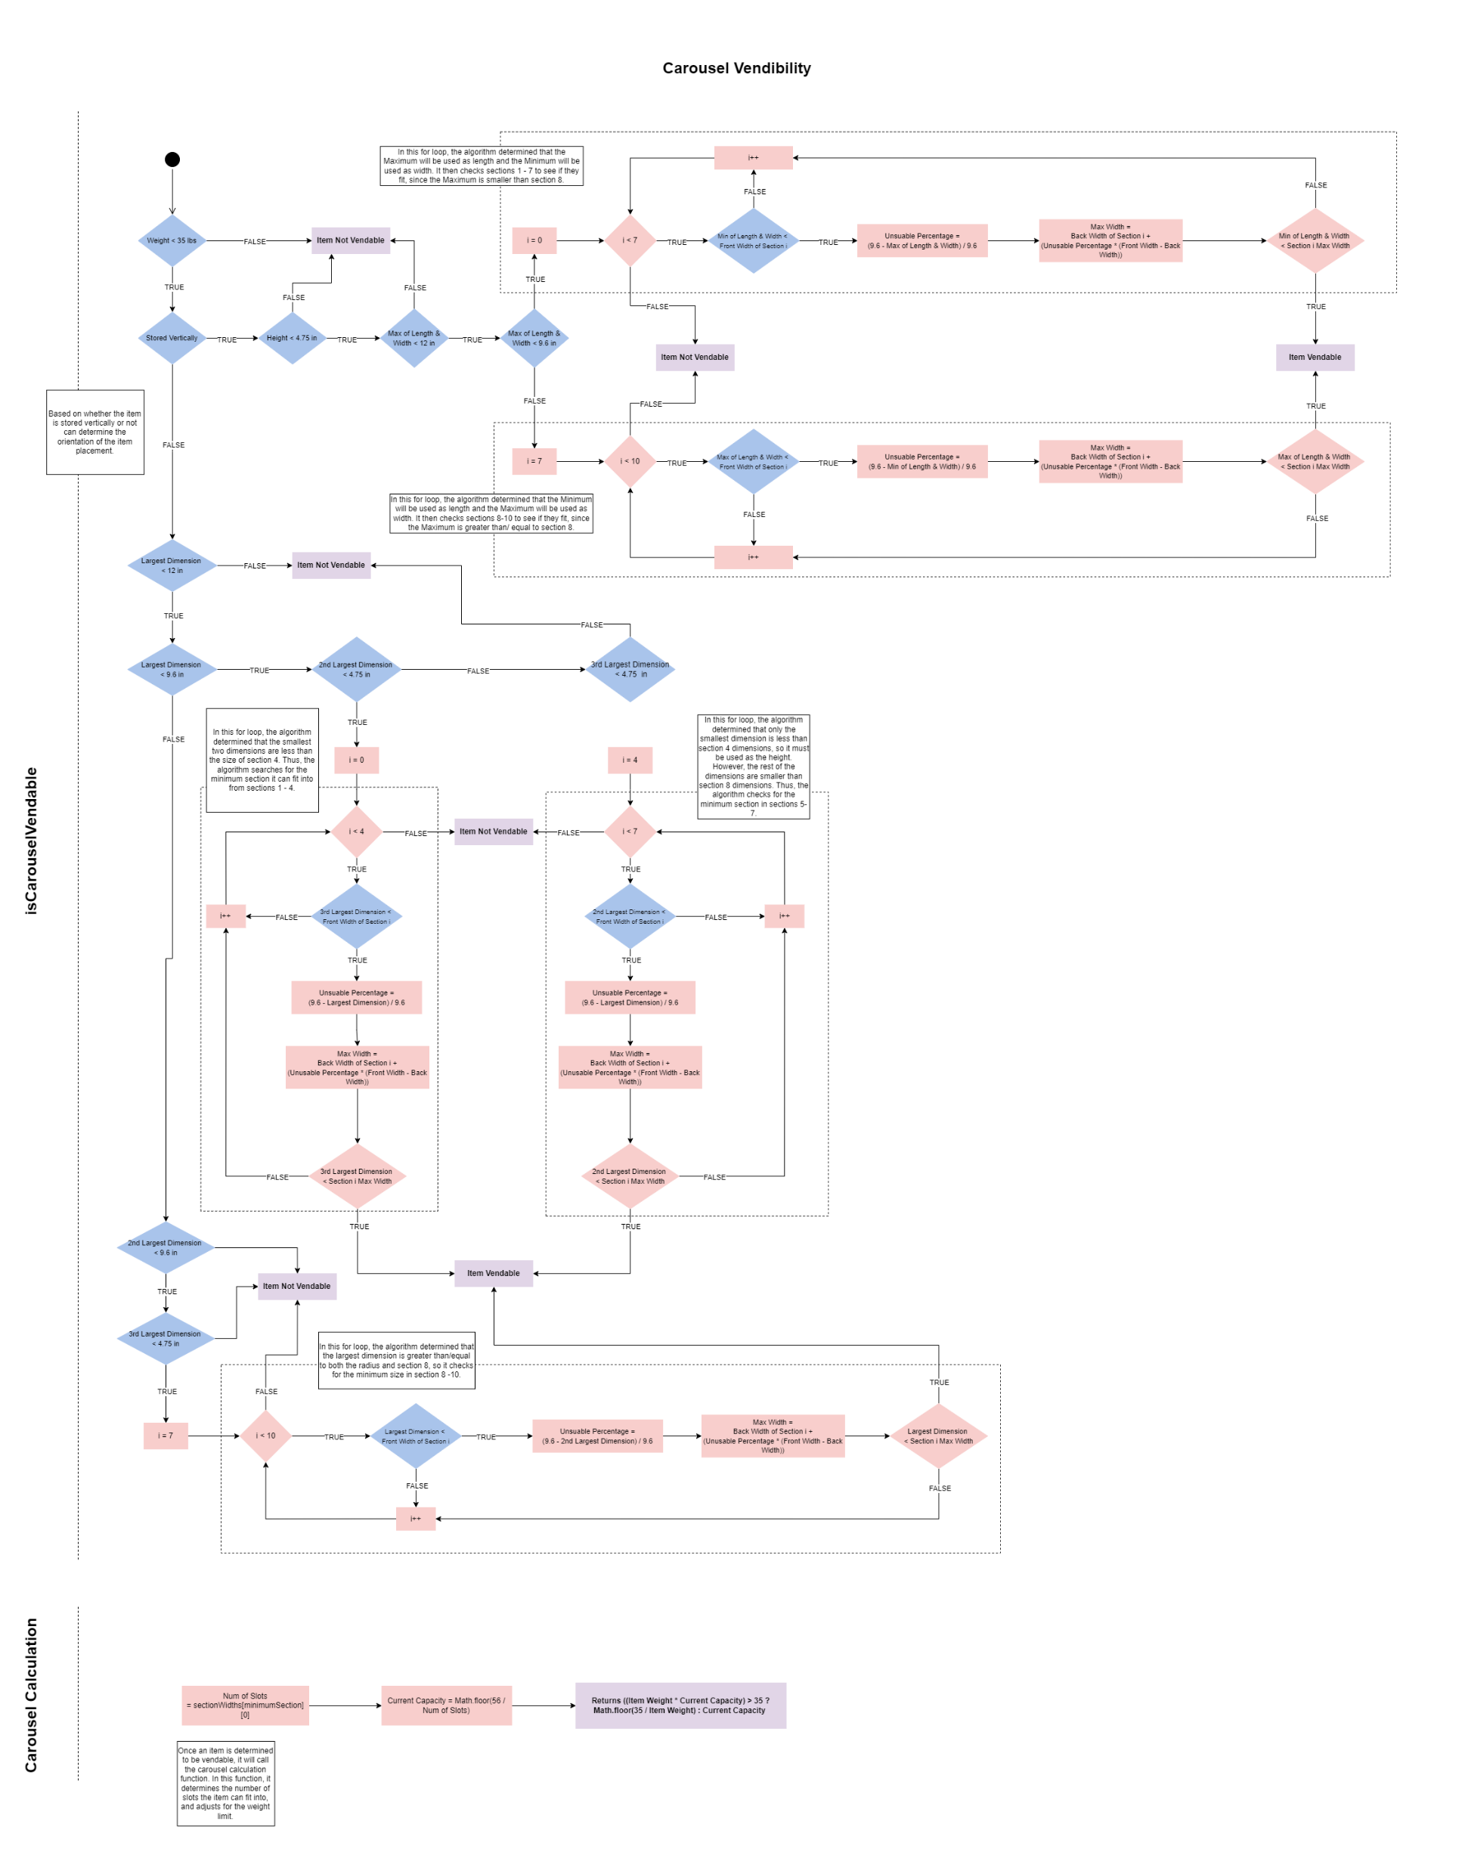
Carousel Vendibility
Determines Vendibility by comparing item dimensions to each carousel section.
Initially determines whether item dimensions are smaller than carousel dimensions.
Once orientation of item placement is determined, the algorithm finds the unusable percentage and compares the maximum width to item width.
Calculates capacity by determining the smallest section the item can fit into and adds 1 for every next section.

Slide 18
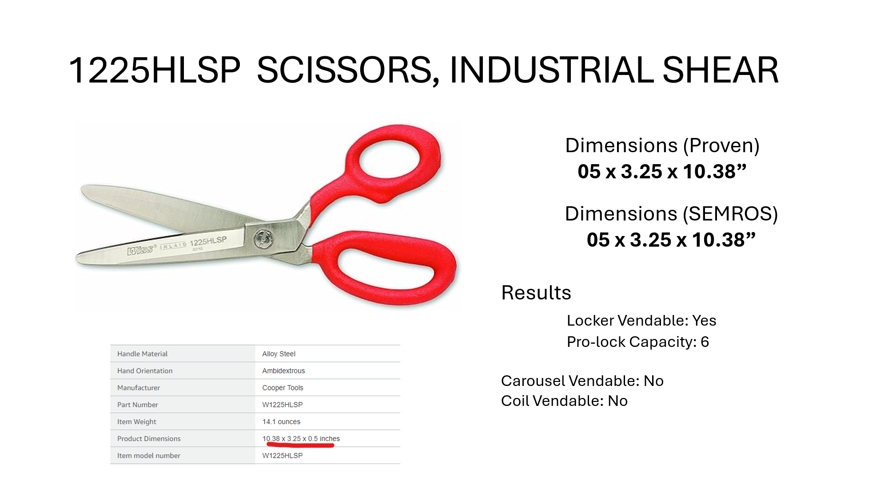
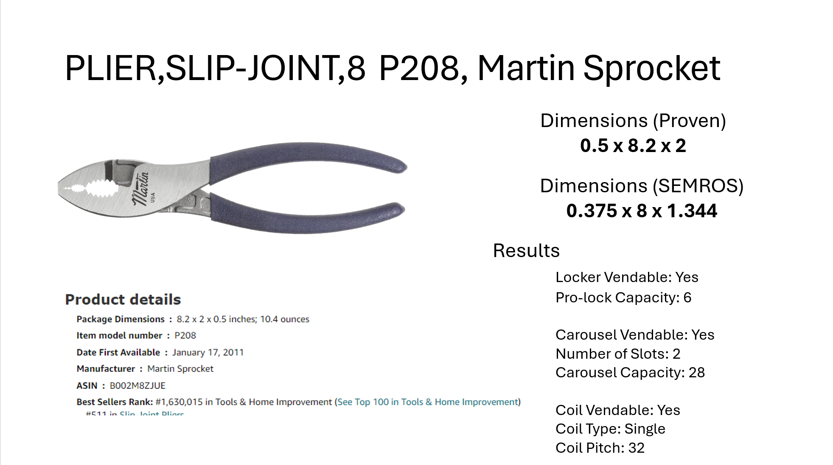
Vendibility Results

Slide 19
Further Improvements
Integration with Solution Generator
Spatial Reasoning in Algorithms
AI Generated Confidence Values and Human Validation

Slide 20


Questions or Comments?

